Slide 1
Swift Airlines -IAD Airport Turnover analysis
November, 2017

Slide 2
Agenda
Scenario
Turnover analysis process flow
Cause of Termination
Breakdown of Voluntary Terminations
Breakdown of Involuntary Terminations
Current Labor Overview
Employee Paid Utilization
Wage Analysis
Wage Environment Overview
Exited employee Geography
Labor Market Overview
Local IAD Available Jobs
Overview of Handling Attrition

Slide 3
Scenario
Swift Airlines is a Regional and Charter airline company located in Northern Virginia area. It currently flies from DCA, IAD and BWI Airports.
The IAD airport location is experiencing a high turnover. The CEO of Swift Airlines has requested the Financial and HR analysts’ of his team to provide an in-depth analysis on the causes for the high turnover as well as recommendations.

Slide 4
Turnover Analysis Process Flow
Determine Cause of Termination (Involuntary vs Voluntary)
Conduct thorough review using data set
- BLS DATA set and Lawson ERP System’s Dataset
Recommendations based off of research

Slide 5
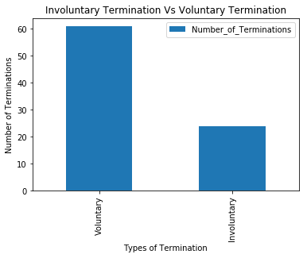
Cause of termination- YTD
Voluntary | Involuntary
Resignation- Other opportunities | Attendance Violation
Resignation- Relocation | Job Performance
Resignation- Unknown | Termination of cause
Data Set:
-Company’s ERP System’s Data
-CSV File

Slide 6
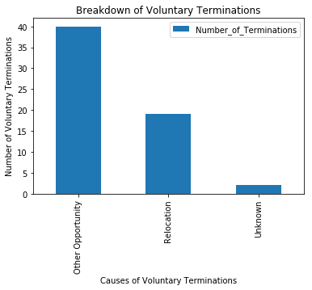
Breakdown of Voluntary termination - YTD
Other Opportunities(Variables)
- Wages
- Benefits

Slide 7
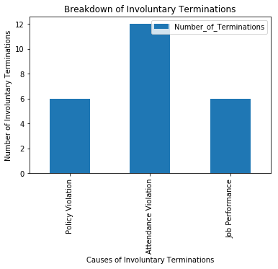
Breakdown of Involuntary termination-YTD
Involuntary (Variables)
- Onboarding and Training
- Performance Monitoring and Enrichment

Slide 8



Current labor overview
Ground handling and cargo pay rates average below the first 15th percentile of the range for the station. Average pay rate across these stations is lower than the starting rate at many competitors.
Ramp
Headcount, 2017
2017 avg. rate and range*
53
$10.17
$10.10
$10.90
Hourly
Passenger Service
Headcount, 2017
2017 avg. rate and range*
43
43
$10.53
Hourly
$10.10
$11.14
Cleaning
Headcount, 2017
2017 avg. rate and range*
17
$10.42
Hourly
$10.10
$11.14
Notes: * indicates hourly employees only were considered for wage averages, wage ranges are min and max of active employees within each labor group

Slide 9
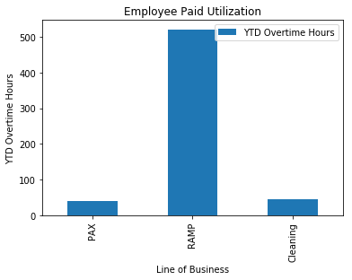

Employee paid utilization
Year to date Overtime by Line of Business (1.5/2.0) spend, 2017
Outage hours (K)
OT Spend USD (K)
Notes: 2017 OT spend includes OT 1.5 and 2.0; excludes unpaid time off.
Source: Swift payroll Data

Slide 10
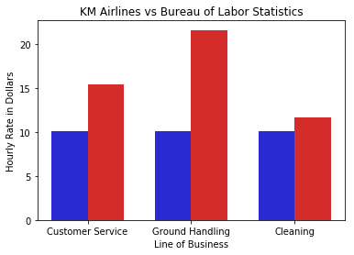
Wage analysis
$22.25
Swift Airline vs BLS
U.S. Bureau of Labor Statistics
The BLS is a governmental statistical agency that collects, processes, analyzes, and disseminates essential statistical data to the American public.
Passenger Service → Customer Service
Ramp → Ground Maintenance
Aircraft Cleaners → Cleaning Maintenance
Data Source:
-BLS Website- JSON File/ XLXS File
$15
$11.50
$10.10
$10.10
$10.10

Slide 11
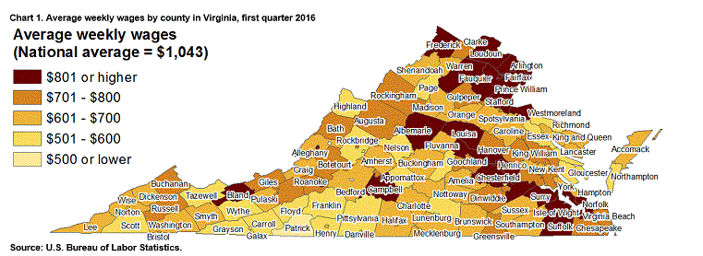
Wage environment overview
Virginia and the federal government have set a legal minimum wage - Virginia's is $7.25 per hour, while the federal minimum wage is $7.25 per hour. The legal requirements do not come close to the local cost of wages for skilled and unskilled labor in the surrounding area.
Employment increases in Loudoun county ranked third highest in nation. Loudoun has the fastest rate of employment growth in the state, at 6.2% currently.

Slide 12








LOCAL IAD Available jobs
Swift is competing against certain employers who offer higher initial pay, many are coupled with an easier workload and indoor work environment
Company | Position | Starting rate $ | Bonus | Location | Heavy Lifting
Swift Airlines | Ground Handling | $10.10
Walmart | Sales Assoc. | $13.00
G2 Security | Security Agent | $12.00
TSA | Transportation Security Agent | $17.00
ABM Aviation | Floor tech | $13.00
Super Shuttle | Cust. Svc. | $13.00
While there are other openings that pay at or below Swissport’s starting level, there are also many others that offer a higher starting rate, driving a gap greater than $1
Source: Weblinks available on last page.

Slide 13
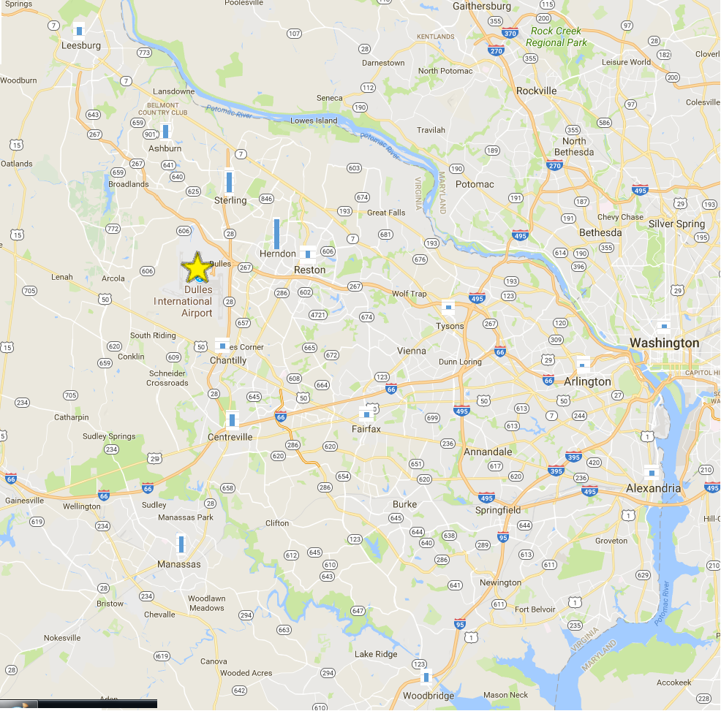
Exited employee geography
Drive distance from the most common location is an average of 8.8 miles each way; average commute time is 25 minutes each way.
Notes: *Average cost is a one-way fare; miles to IAD is the distance from the zip code to IAD per the fastest route as provided by Google Maps; Transportation methodology, time, and costs are provided by Google Maps and are as of September 16, 2017.

Slide 14
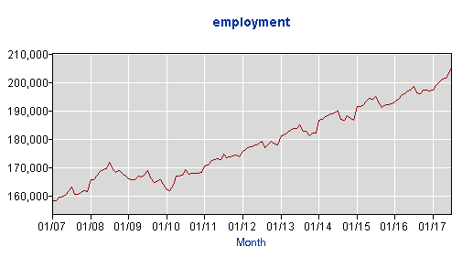
Labor market overview
Loudoun County has had steady growth in employment, which has driven unemployment to a low 3.2%; cost of employment and living is significantly higher than the national average.
Loudoun County Employment Rate
Cost of living comparison
Category | Median Expense
 | National | Metro Area | Vari.
1 bedroom rent** | $1,230 | $2,271 | 85%
1 gallon milk* | $3.17 | $3.73 | 18%
1 dozen eggs* | $1.33 | $3.40 | 159%
1 gallon gas^ | $2.30 | $2.53 | 10%

Slide 15



Example graphic: demonstrating Swift Airline total comp (Ramp, PAX, cleaning)
What is my total compensation at Swift Airlines?
It is more than just your hourly wage.
Additional Benefits:
Employer Paid Parking
401(k) with Employer match
Company Paid Life Insurance
PTO Accrual (40 Hours)- Begins Year One
Paid Holidays and Bereavement Pay
Parking
.60 increase after 6 months of emp.
Market competitive wages
Covered health insurance
Retention Increase
All additional benefits
+ $21,008*
+ $1,274
+ $624
+ $2,790
Potential total compensation
+ $
$12.35
$ per hour

Slide 16




Overview of handling attrition
While the cost implication of increased wages may be offset by reducing training expenses, Swift Airline will realize additional benefit from improving retention and increasing attraction
Improving attrition and attraction requires a comprehensive approach
Attracting an employee
Competitive entry hourly wage
Primary benefits (health, vacation, etc.)
Secondary benefits (parking, trans., meals)
Keeping an employee
Strong supervisor leadership
Investments in employee training
Culture that motivates growth & rewards performance
Even with improvements to wages, those that want to leave will leave
Initially, attrition may not be immediately improved; this will be heavily influenced by culture
Improving the culture via enhanced training for supervisors will have a lagging, but beneficial impact
Once the changes take effect, the benefit will be greater than savings driven by reduced training
Enhanced culture, motivating employees and fostering dedication
Improved employee predictability and scheduling
Enhanced Service to customers, protecting revenue sources
Reduced safety incidents and equipment damages

Slide 17
Thank you

